Slide 1

Algebra 1
Unit 5, Lesson 1 Solving Multi-Step Equations Volume 1, pg. 231

Slide 2


Benchmark
MA.912.AR.2.1
Given a real-world context, write and solve one-variable multi-step linear equations.
volume 1, pg. 231

Slide 3
Integrated Mathematical Thinking and Reasoning Standards
MA.K12.MTR.4.1 Engage in discussions that reflect on the mathematical thinking of self and others.
MA.K12.MTR.5.1 Use patterns and structure to help understand and connect mathematical concepts.
MA.K12.MTR.6.1 Assess the reasonableness of solutions.
volume 1, pg. 231

Slide 4

Learning Target
I can solve multi-step linear equations.
volume 1, pg. 231

Slide 5

Warm-Up
volume 1, pg. 231

Slide 6

5.1.1 Warm-Up: Aviation Careers
Aviation careers include pilots, air-traffic controllers, airport operators, airfield maintenance, aircraft rescue and firefighting, law enforcement and security officers, and project management.
Which of these careers in aviation had you not heard of before?
Have you ever thought about a career in aviation?
volume 1, pg. 231

Slide 7

Refresher
volume 1, pg. 232

Slide 8

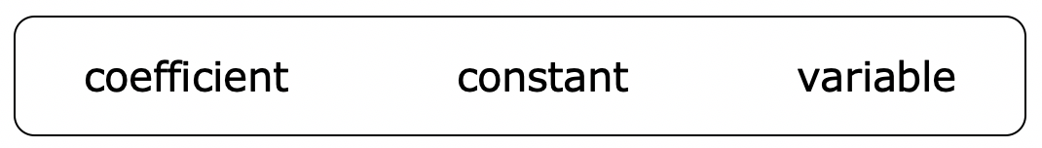
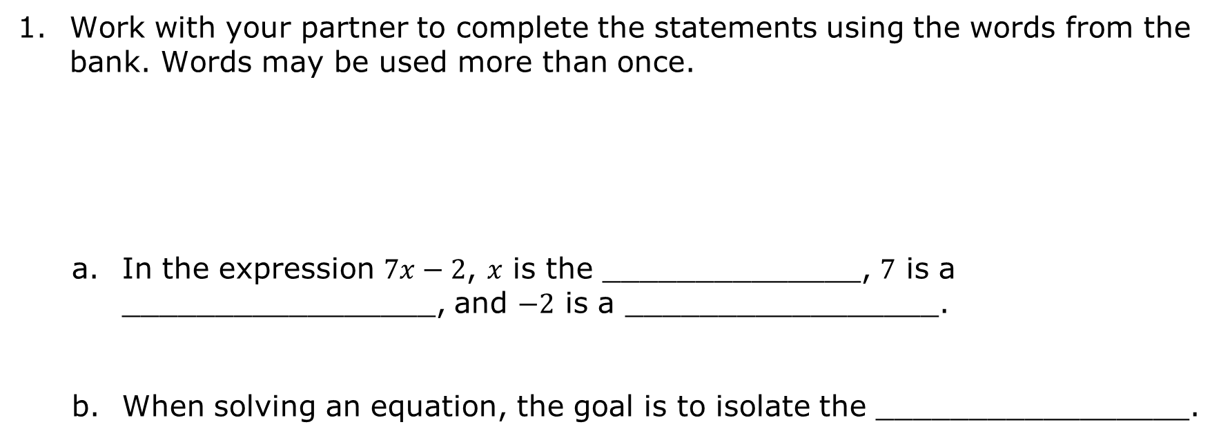
5.1.2 Refresher: Solving Two-Step Equations
Work with your partner to complete the statements using the words from the bank. Words may be used more than once.
In the expression $7x−2$, $x$ is the ______________, $7$ is a _________________, and $−2$ is a _________________.
When solving an equation, the goal is to isolate the _________________.
volume 1, pg. 232

Slide 9

Solve each equation and verify your solution using substitution.
$8.25−1.5y=1.8$
$21=36\left(\frac{2}{3}a+\frac{5}{4}\right)$
volume 1, pg. 232

Slide 10
Compare your work with your partner’s. Summarize any similarities and/or differences in your solution methods.
volume 1, pg. 232

Slide 11

Collaboration
volume 1, pg. 233

Slide 12

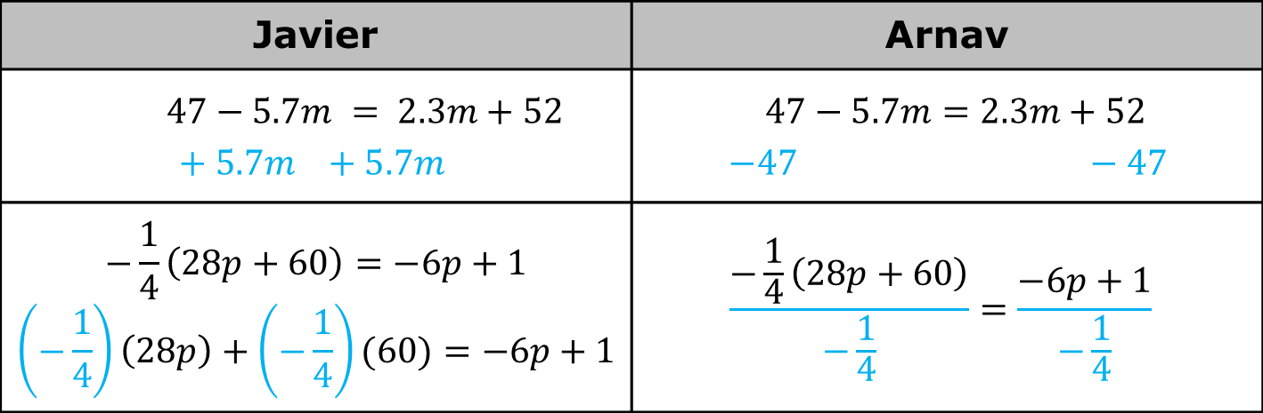
5.1.3 Collaboration: Solving Multi-Step Equations
Javier and Arnav solved the same two equations, but they used different first steps.
In the table, each student’s first step for solving each equation is started in blue. Work with your partner to finish solving the equations, continuing from each student’s first step.
Javier | Arnav
$$47−5.7m = 2.3m+52$$ $$+ 5.7m +5.7m$$ | $$47−5.7m=2.3m+52$$ $$−47 −47$$
$$−\frac{1}{4}\left(28p+60\right)=−6p+1$$ $$\left(−\frac{1}{4}\right)\left(28p\right)+\left(−\frac{1}{4}\right)(60)=−6p+1$$ | $$\frac{−\frac{1}{4}\left(28p+60\right)}{−\frac{1}{4}}=\frac{−6p+1}{−\frac{1}{4}}$$
volume 1, pg. 233

Slide 13
Discuss with your partner why both students had the same solutions for each equation, even though they used different strategies.
Discuss which strategies you preferred to start with when solving each of these equations. Summarize your discussion.
volume 1, pg. 233

Slide 14

Guided Practice
volume 1, pg. 234

Slide 15


5.1.4 Guided Practice: Solving Multi-Step Equations
Solve each equation and verify the solution using substitution.
$8+5\left(16+9g\right)=35g$
$49 − 6d=\frac{3}{2}\left(28d−10\right)$
$\frac{62k−27}{11}=8k+7$
volume 1, pg. 234

Slide 16

Your Turn
volume 1, pg. 234

Slide 17

5.1.5 Your Turn!
Solve each equation.
$4.7y+1.6−0.2y=6.6$
$\frac{8}{3}+29z+1=7z−\frac{1}{3}$
volume 1, pg. 234

Slide 18

Wrap-Up
volume 1, pg. 235

Slide 19
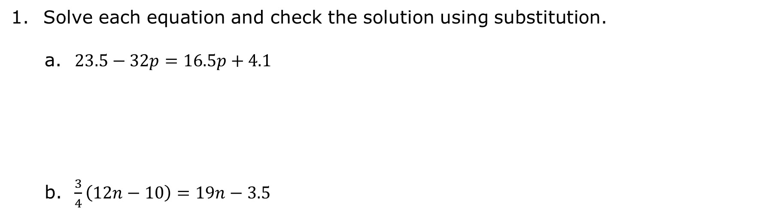
5.1.6 Wrap-Up: Cool Down
Solve each equation and check the solution using substitution.
$23.5−32p=16.5p+4.1$
$\frac{3}{4}\left(12n−10\right)=19n−3.5$
volume 1, pg. 235

